Slide 1
Computer Graphics: Rendering
Lecture 2: Imaging-- Radiometry, Photometry
Kartic Subr

Slide 2
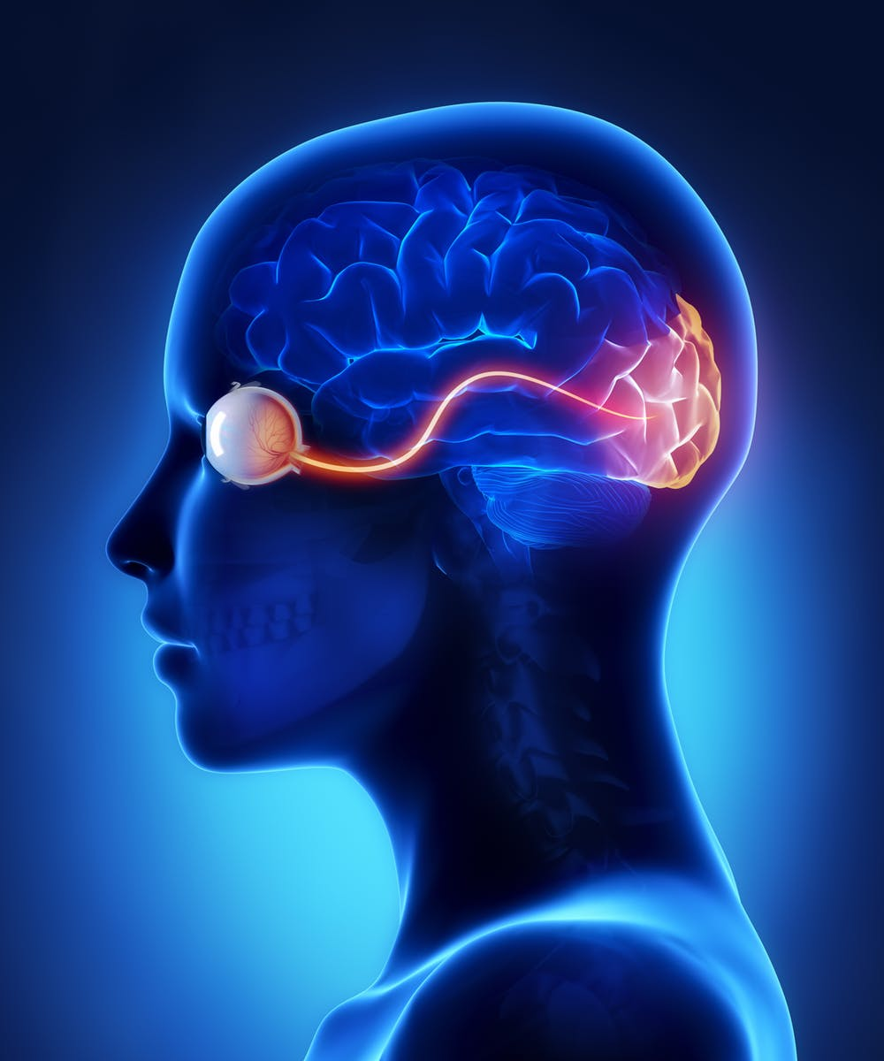
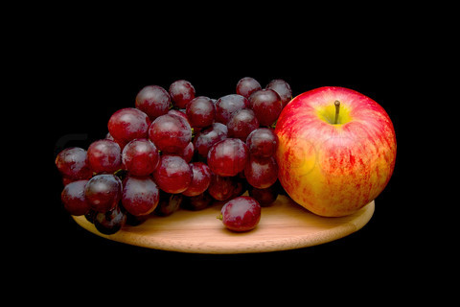
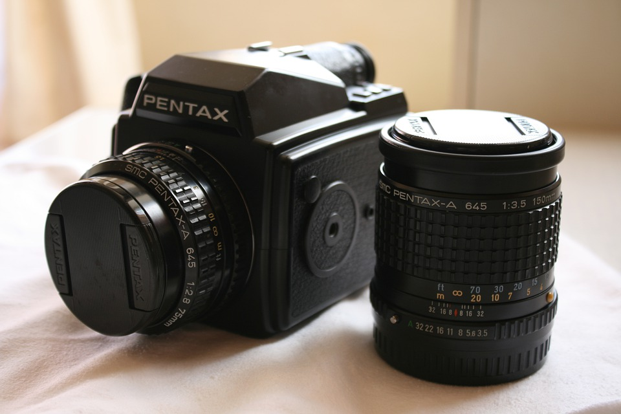

Computer Graphics
Real
photography
image manipulation
rendering
Virtual

Slide 3
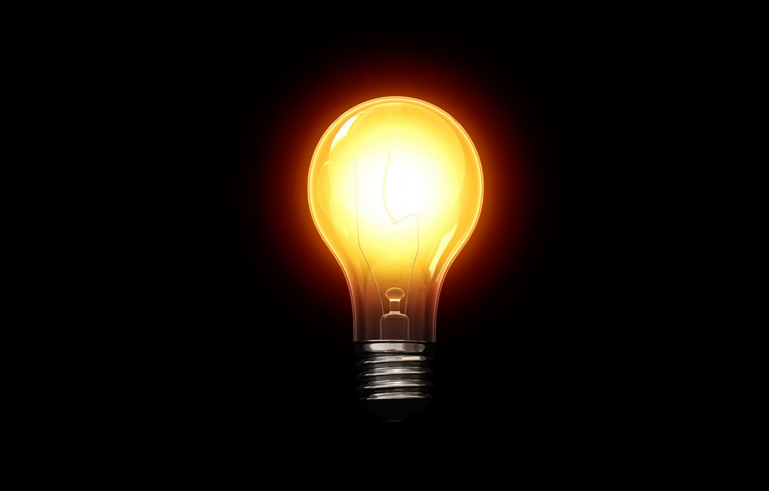
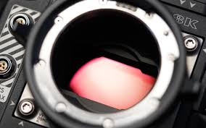
Energy in the scene
Cool visualization in this video

Slide 4

What do cameras record?
Obviously, it is …ehmm
…‘light stuff’?

Slide 5
What is light?

Slide 6
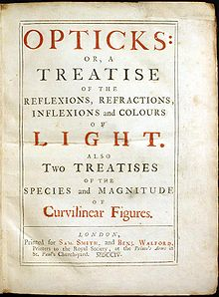
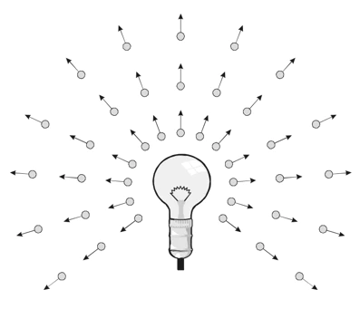
What is light?
Isaac Newton 1704

Slide 7
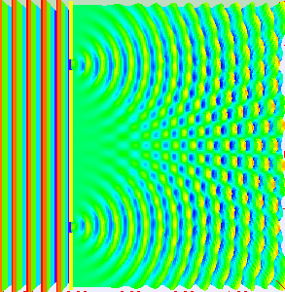
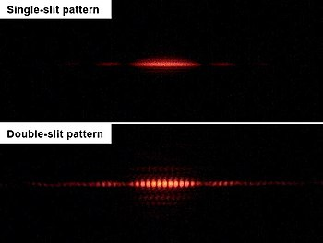
What is light?
Isaac Newton 1704
Thomas Young 1801

Slide 8
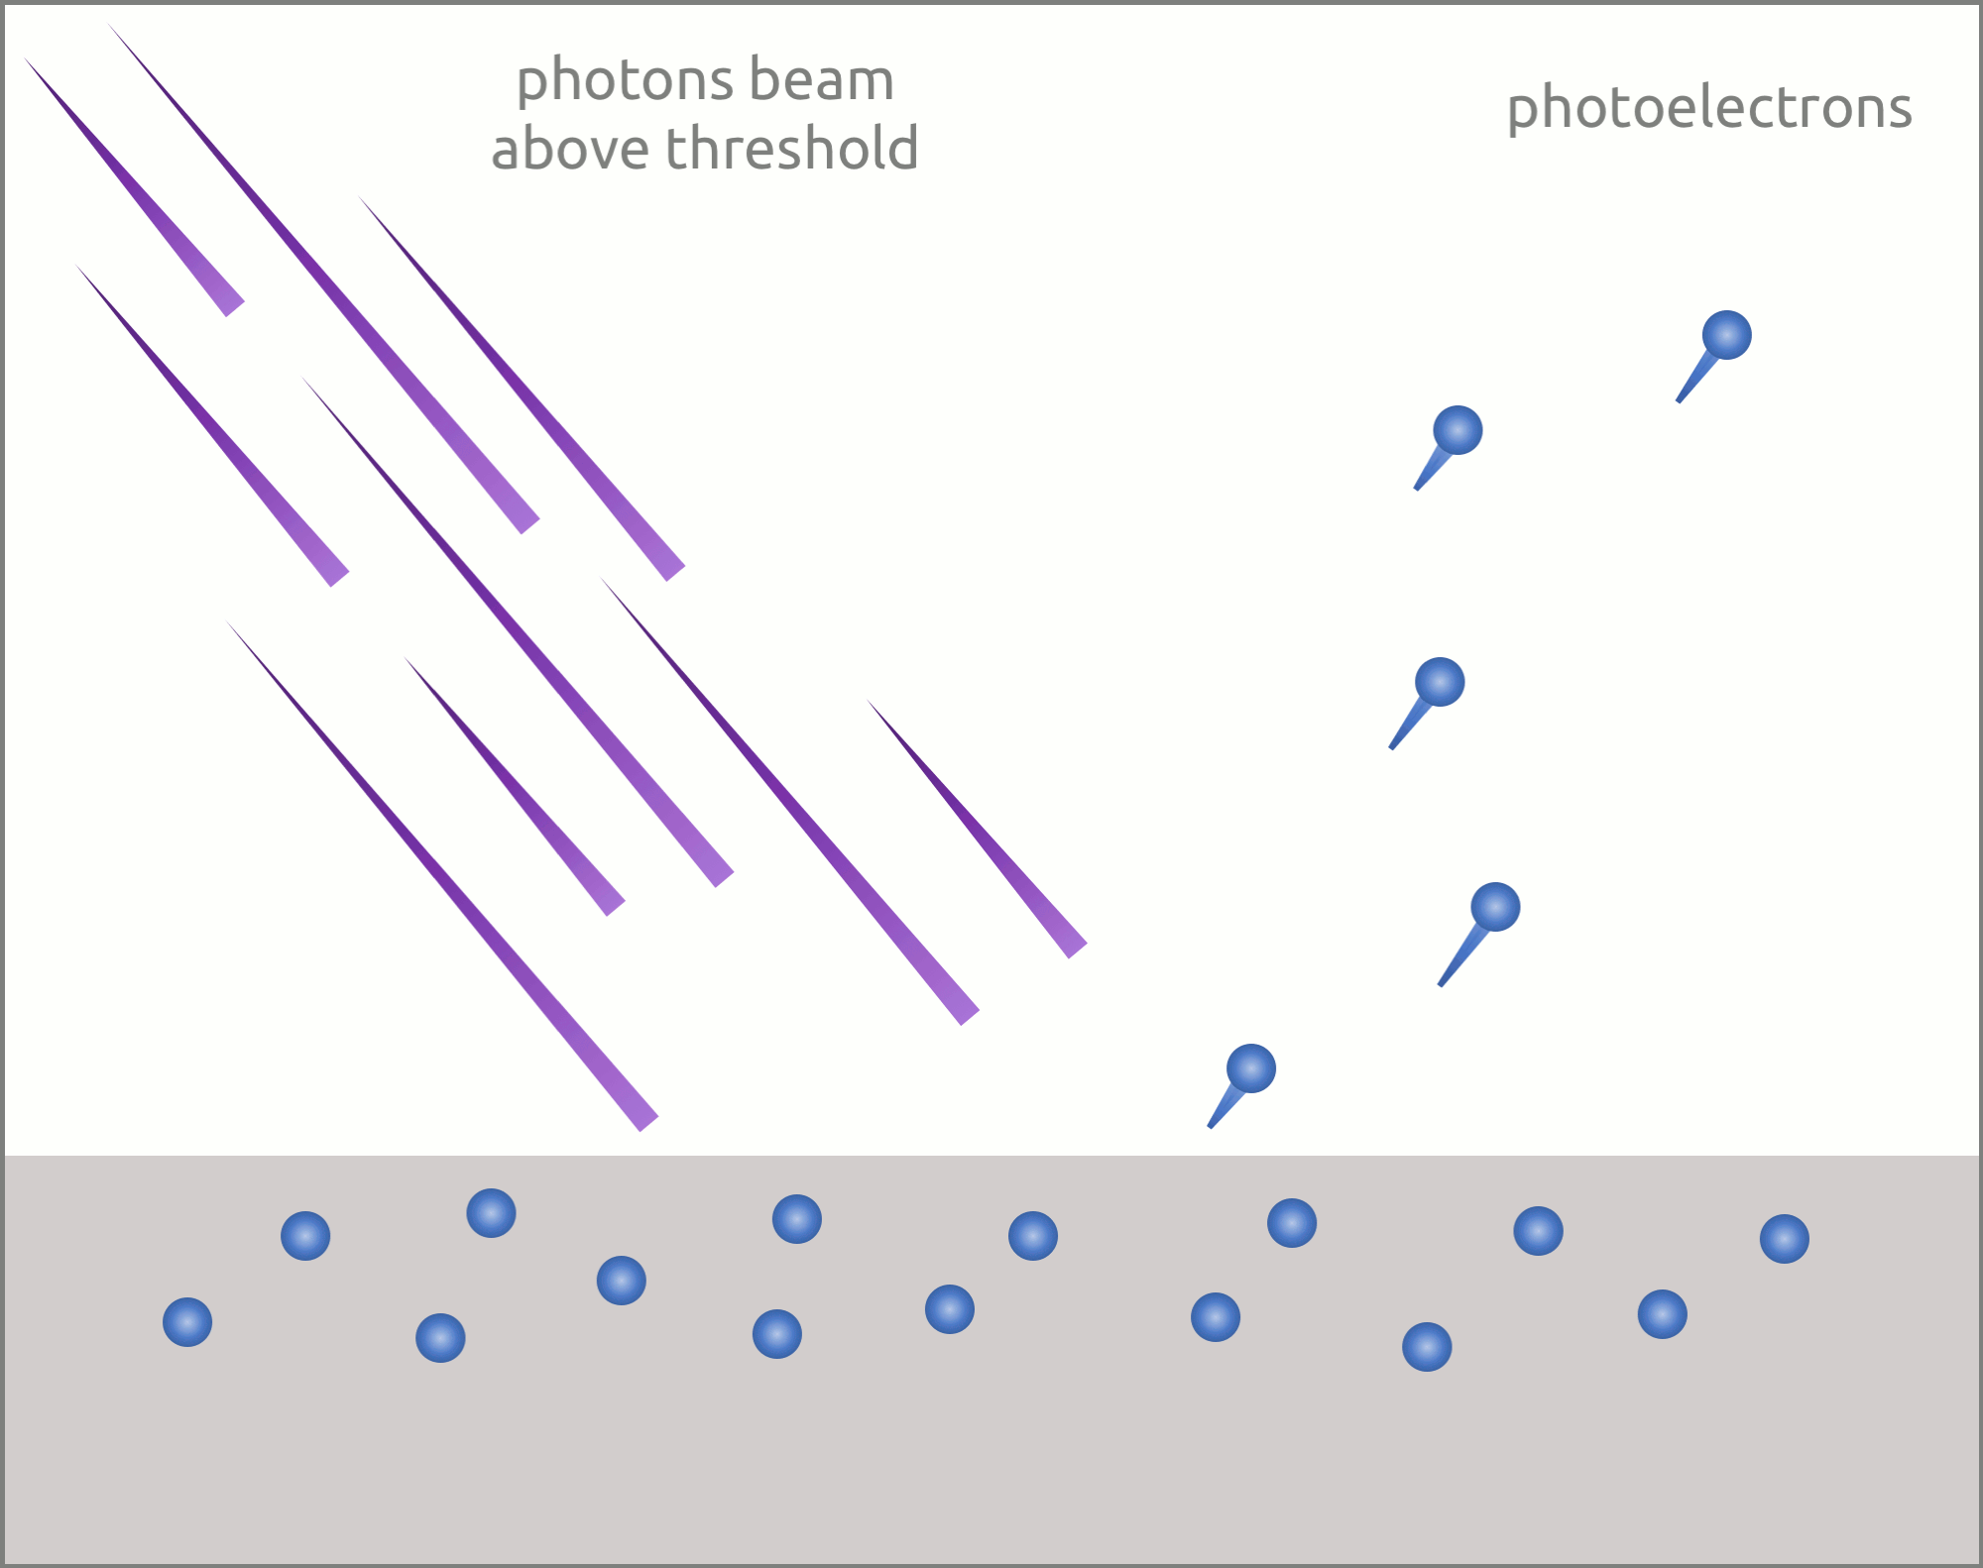
What is light?
Isaac Newton 1704
Thomas Young 1801
1887 Hertz, 1902 Lenard, 1905 Einstein

Slide 9
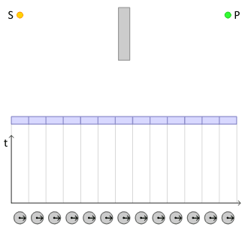
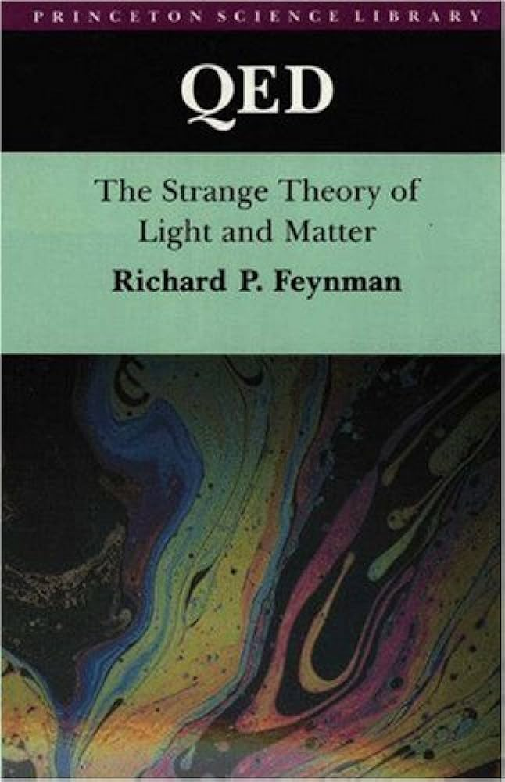
Straight lines?
Feynman 1985, read this

Slide 10
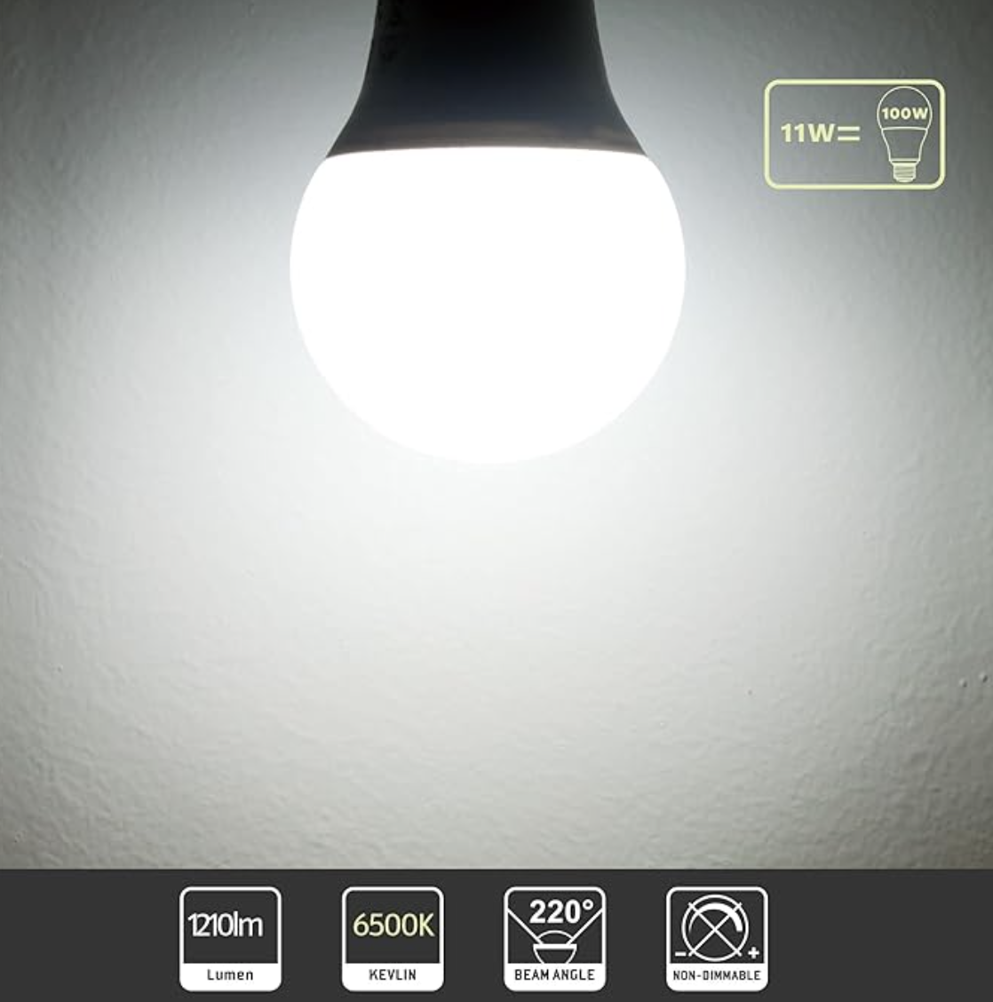
ROTTYI Light Bulbs
100W Equivalent, 6500K Bulbs, 11W 1210LM LED

Slide 11
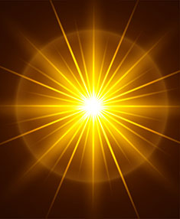
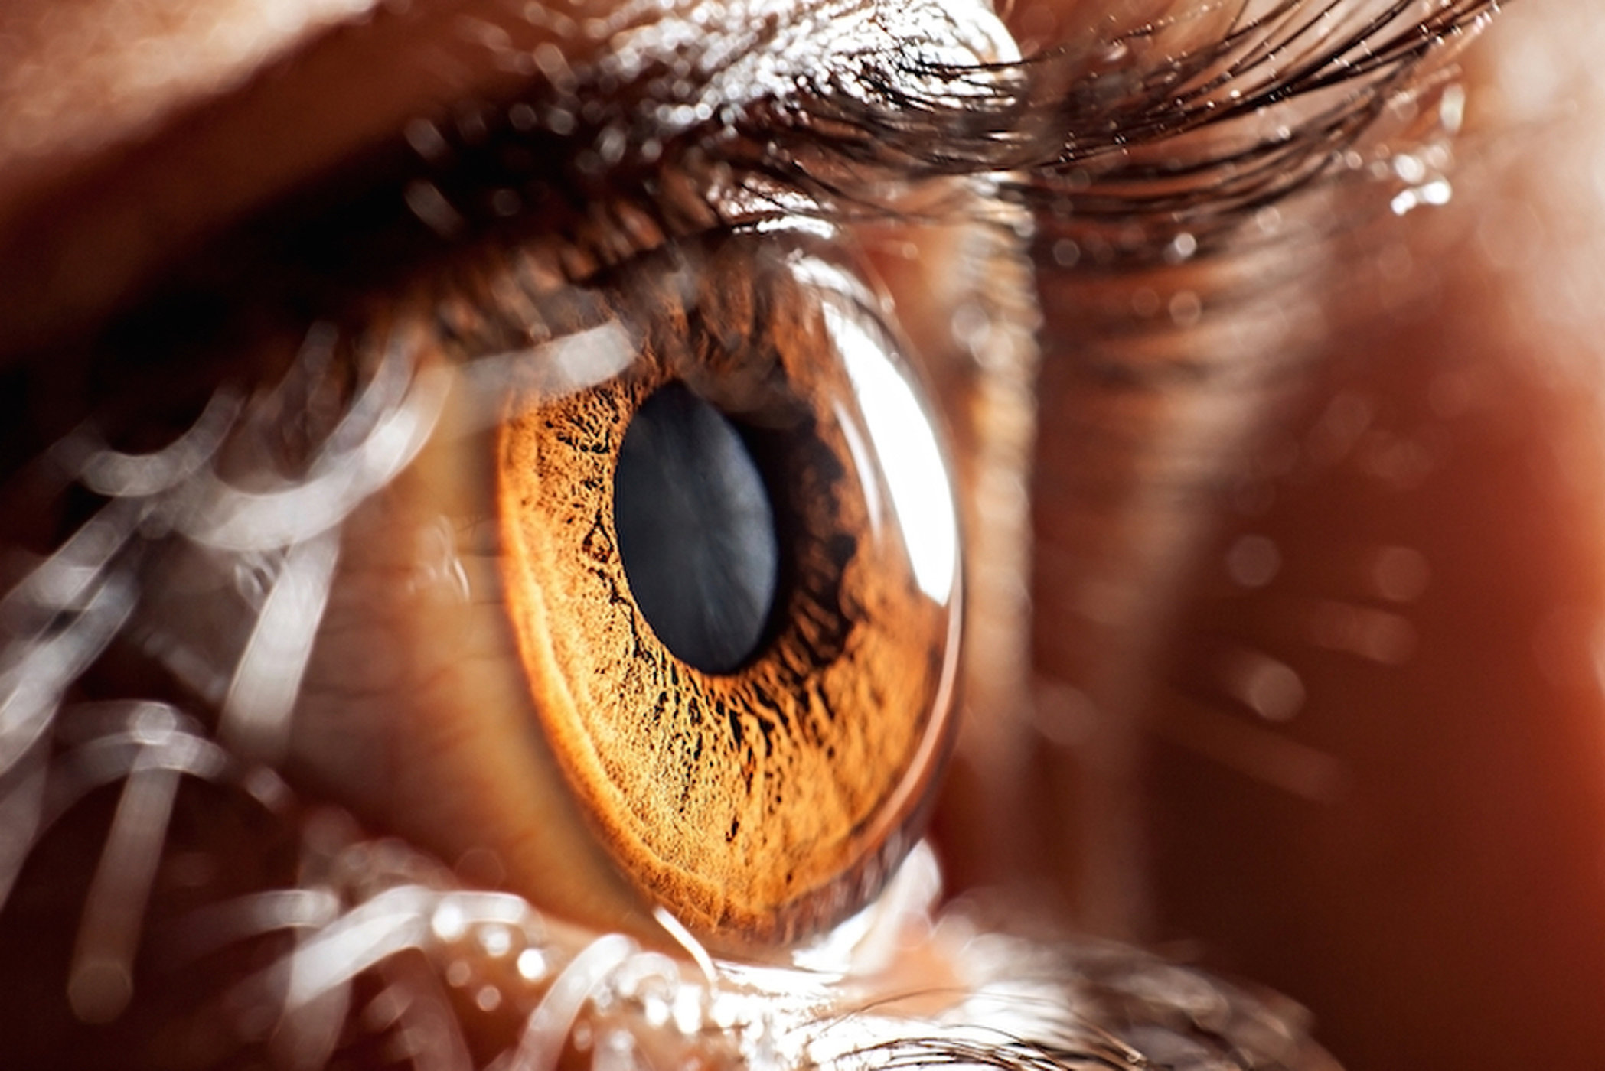
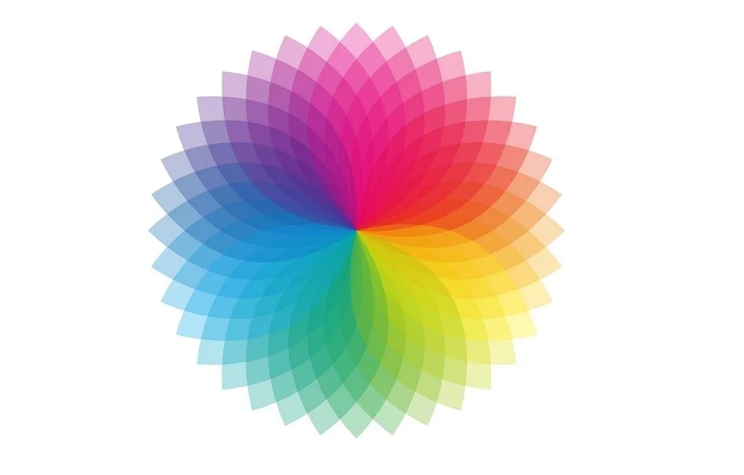
The study of light
radiometry
photometry
colorimetry
Interested in knowing more? Read this

Slide 12
The study of light
photometry

Slide 13
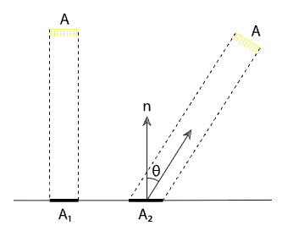
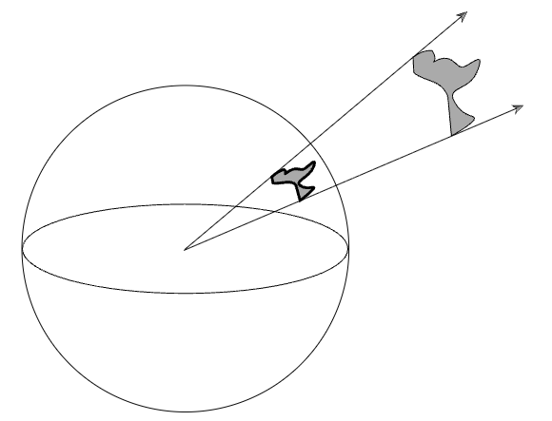
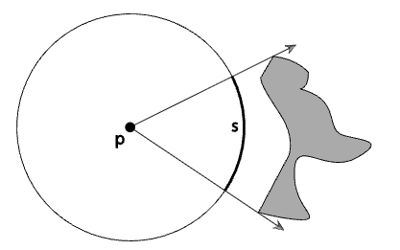
Radiometry
per area
per time
energy
power
per direction
https://pbr-book.org/3ed-2018/Color_and_Radiometry/Radiometry#sec:radiometry

Slide 14
Radiometry
irradiance
per area
per direction
Watt/m²
per time
energy
power
radiance
Watt
Watt/ m² Sr
Joules
per direction
per area
radiant
intensity
Watt/Sr

Slide 15
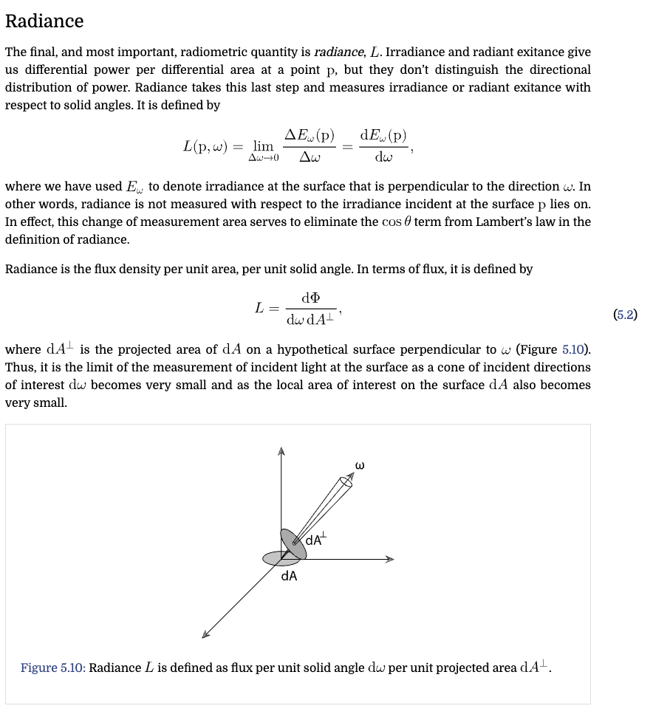





Radiometry
$$\frac{∂}{∂A}$$
$$\frac{∂}{∂ω}$$
irradiance
$$\frac{∂}{∂t}$$
per area
per direction
per time
energy
power
radiance
per direction
per area
$$\frac{∂}{∂ω}$$
radiant
intensity
$$\frac{∂}{∂A}$$

Slide 16
Radiometry
$$\frac{∂}{∂A}$$
$$\frac{∂}{∂ω}$$
radiosity
$$\frac{∂}{∂t}$$
per area
per direction
per time
energy
power
radiance
per direction
per area
$$\frac{∂}{∂ω}$$
radiant
intensity
$$\frac{∂}{∂A}$$

Slide 17




$$\frac{∂}{∂A}$$
$$\frac{∂}{∂ω}$$
radiosity
$$\frac{∂}{∂t}$$
per area
per direction
per time
energy
power
radiance
per direction
per area
$$\frac{∂}{∂ω}$$
radiant
intensity
$$\frac{∂}{∂A}$$
ROTTYI Light Bulbs
100W Equivalent, 6500K Bulbs, 11W 1210LM LED

Slide 18

Radiometry
Study of light energy in a scene

Slide 19
Radiometric qty. per wavelength
radiosity
per area
per direction
per time
energy
power
radiance
per direction
per area
radiant
intensity
per wavelength?

Slide 20
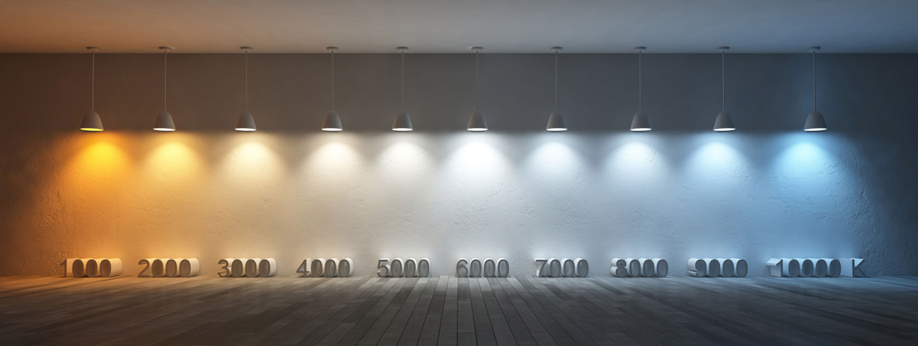
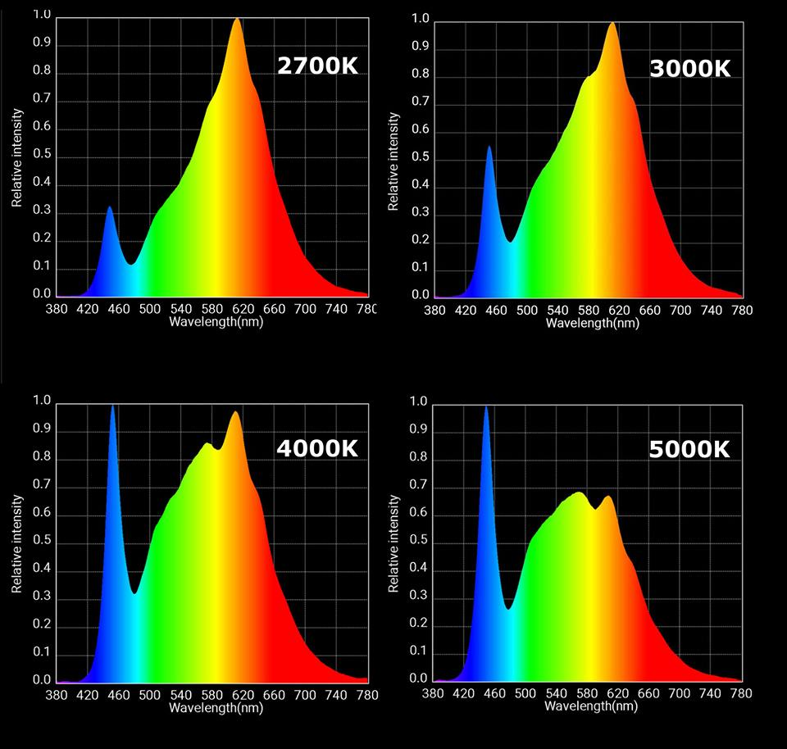
Spectrometry: radiometric qty. per wavelength
radiant
intensity
https://www.softlights.org/chapter-11-color-temperature/
Interested in modelling this? Look here

Slide 21
$$\frac{∂}{∂A}$$
$$\frac{∂}{∂ω}$$
radiosity
$$\frac{∂}{∂t}$$
per area
per direction
per time
energy
power
radiance
per direction
per area
$$\frac{∂}{∂ω}$$
radiant
intensity
$$\frac{∂}{∂A}$$
?

Slide 22
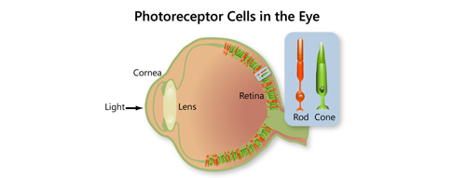
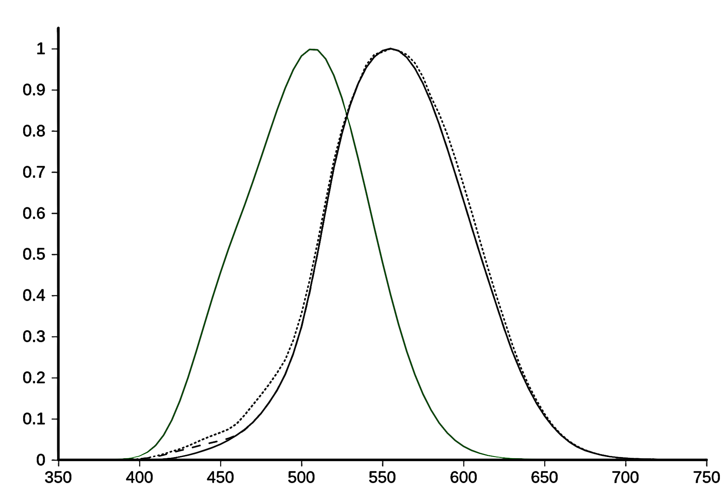

Photometry
Study of perceived light energy in a scene

Slide 23
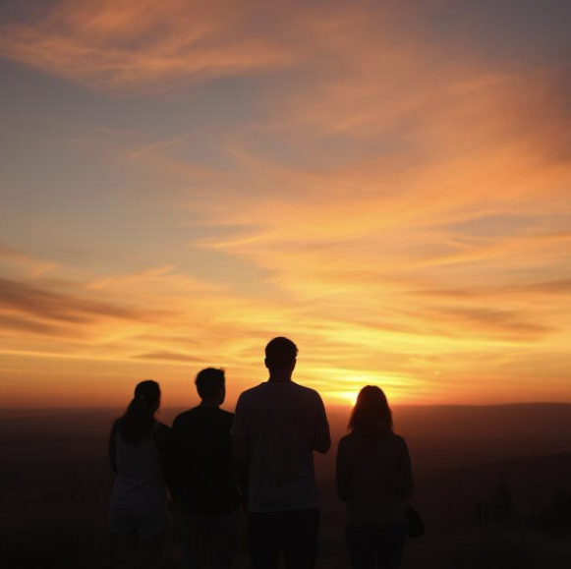
Photometry
Study of perceived light energy in a scene

Slide 24
Photometry
Study of perceived light energy in a scene
see document projector …
Notes:
V(lambda) and luminance as integral

Slide 25
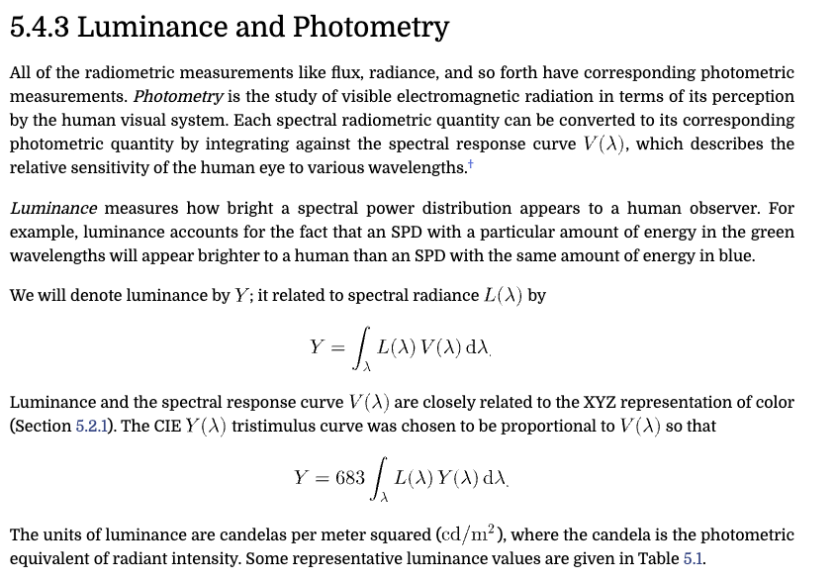

Slide 26
irradiance
per area
per direction
per time
energy
power
radiance
per direction
per area
radiant
intensity
illuminance
luminous
flux
luminance
luminous
intensity

Slide 27
irradiance
power
radiance
radiant
intensity
illuminance
luminous
flux
luminance
luminous
intensity

Slide 28
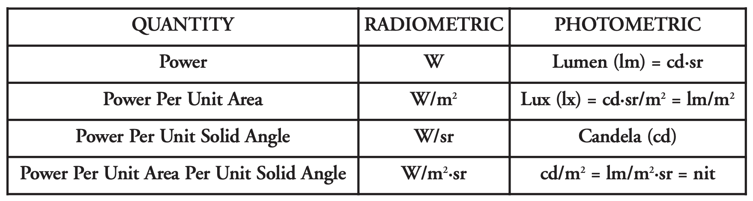

Slide 29
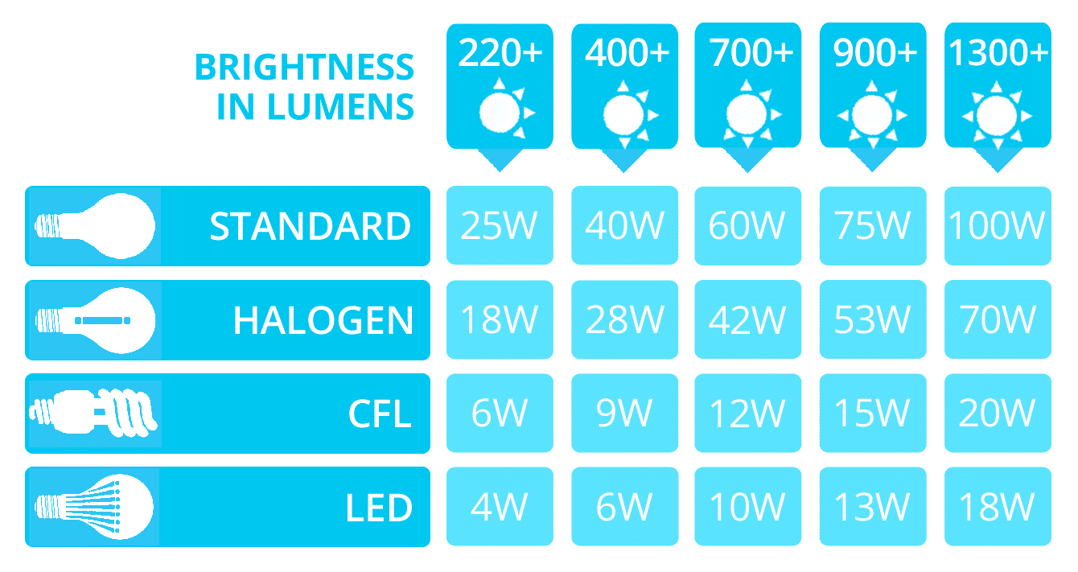

Slide 30
$$\frac{∂}{∂A}$$
$$\frac{∂}{∂ω}$$
radiosity
$$\frac{∂}{∂t}$$
per area
per direction
per time
energy
power
radiance
per direction
per area
$$\frac{∂}{∂ω}$$
radiant
intensity
$$\frac{∂}{∂A}$$

Slide 31
$$\frac{∂}{∂A}$$
$$\frac{∂}{∂ω}$$
radiosity
$$\frac{∂}{∂t}$$
per area
per direction
per time
energy
power
radiance
per direction
per area
$$\frac{∂}{∂ω}$$
radiant
intensity
$$\frac{∂}{∂A}$$

Slide 32

Spectral sensitivity of our eyes

Slide 33
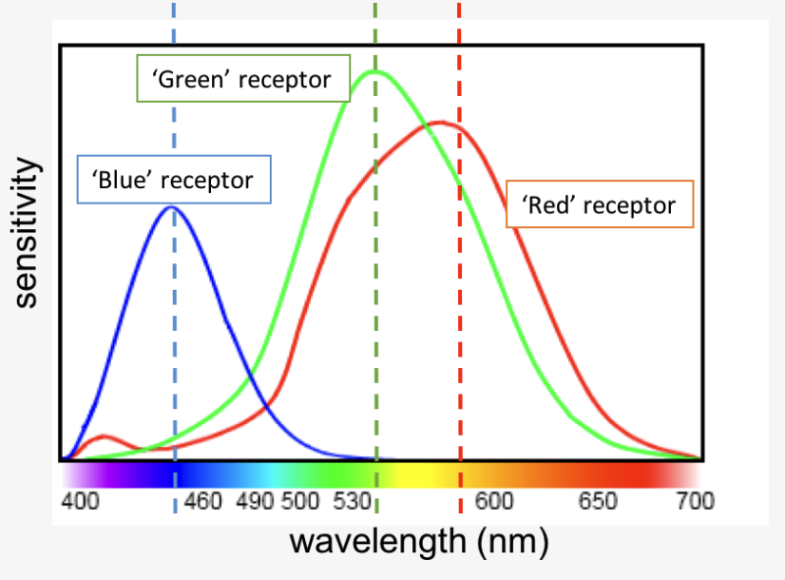

Slide 34

Spectral response of cones

Slide 35

Rods, cones, etc.

Slide 36
plotting S,M,L as 3D points as a function of wavelength

Slide 37


Slide 38
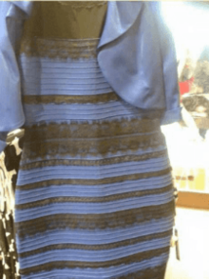
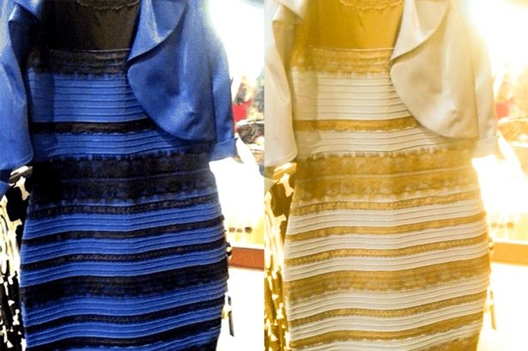
Metamers
http://persci.mit.edu/people/adelson/checkershadow_proof

Slide 39
Colorimetry
Trichromatic theory of light (Thomas Young)
According to the theory, any color can be represented as a combination of stimulation across these three cone types. For example, yellow light (around 580 nm) does not stimulate a “yellow” receptor — instead, it is perceived because it produces a certain ratio of responses between L- and M-cones, with little S-cone activation.
If you woud like to read about the history of this theory …

Slide 40
Trichromatic theory of light

Slide 41
Trichromatic theory of light

Slide 42
Matching Experiment
tweak sliders
r
target colour
observed
colour
g
b

Slide 43
Matching Experiment
g
r
b

Slide 44
Tristimulus values

Slide 45
Tristimulus values

Slide 46
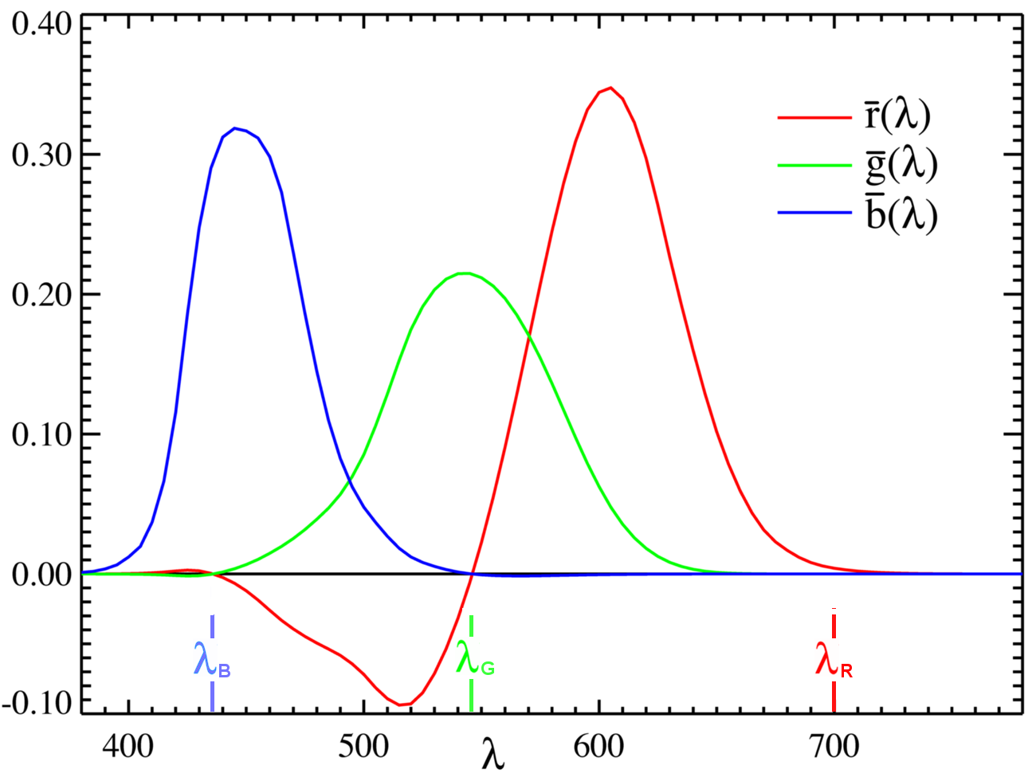
Tristimulus values: RGB matching functions
Confusing? Read more here
(search for ‘Maxwell’ on the page)
or here

Slide 47
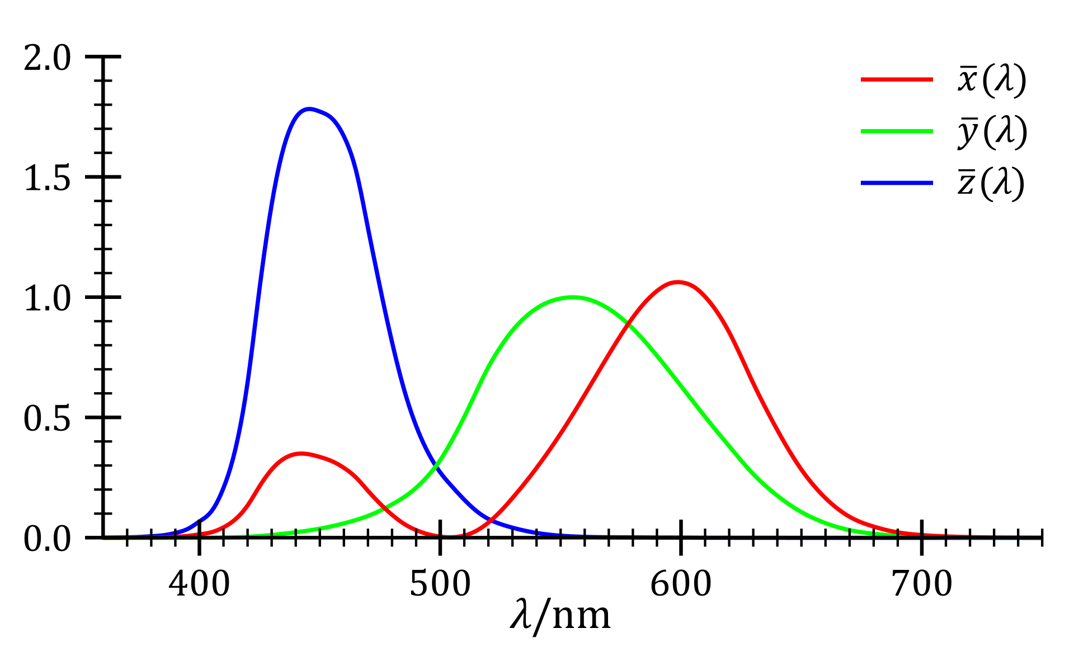
RGB to CIE XYZ space
M

Slide 48
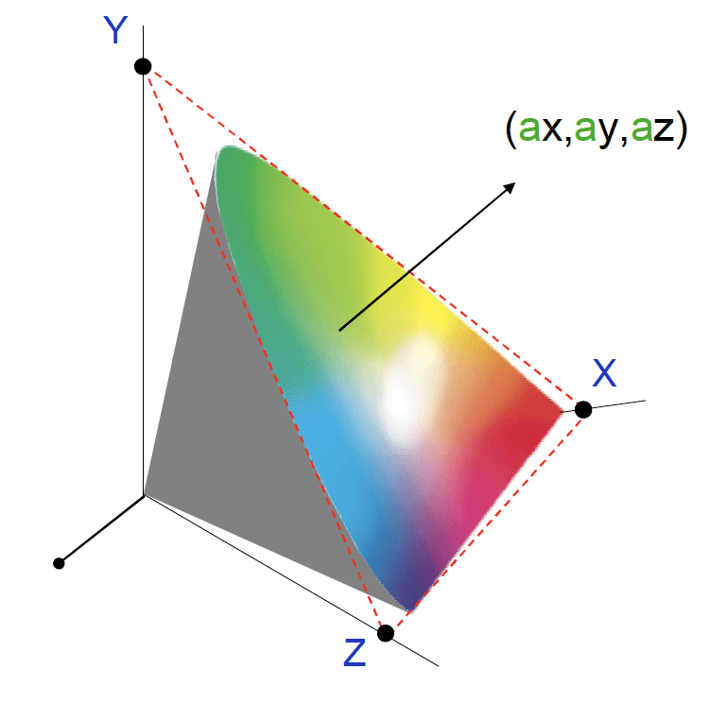

Slide 49
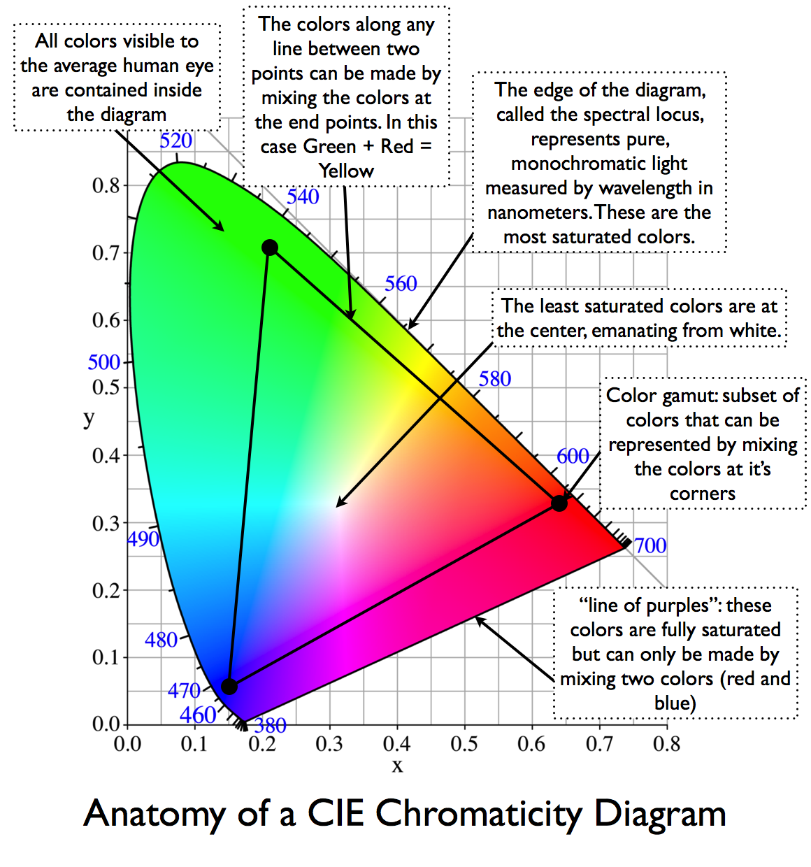
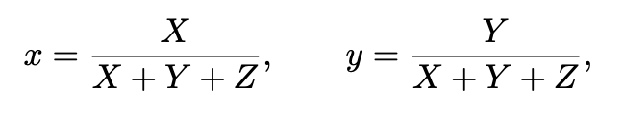

Slide 50
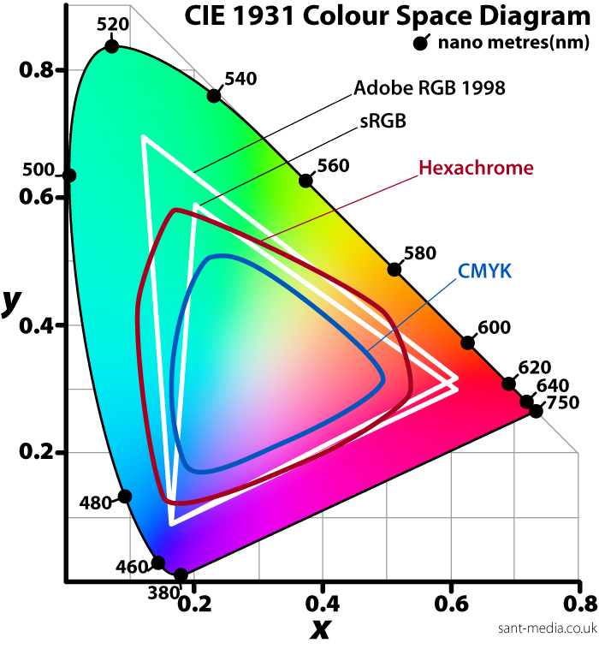
Colour spaces

Slide 51
The study of light
radiometry
photometry
colorimetry
Interested in knowing more? Read this

